Slide 1
Recurrent Neural Network (RNN) Language Models
CS 263: Natural Language Processing
Nanyun (Violet) Peng
Course website: https://vnpeng.net/cs263_sp24.html
syllabus,
announcements,
slides,
homework
1

Slide 2
Important Announcements
Practice Quiz 1 will be released today
12 multiple answer choices questions.
The actual Quiz 1 will be similar in terms of format and difficulty, but there will be 20 multiple answer choices questions.
Friday’s TA discussion session will go over practice Quiz 1 questions – encourage you to take the quiz by yourself before that.
Quiz 1: next Wednesday, in class, for CS graduate students and MENG, while on gradescope next Saturday for MSOL students.
Project planning report dues next Wednesday, 11:50pm.

Slide 3
Outline
Recurrent Neural Networks (RNNs)
Long Short-Term Memory Network (LSTMs)
RNNs/LSTMs for Language Modeling
Decoding Algorithms

Slide 4
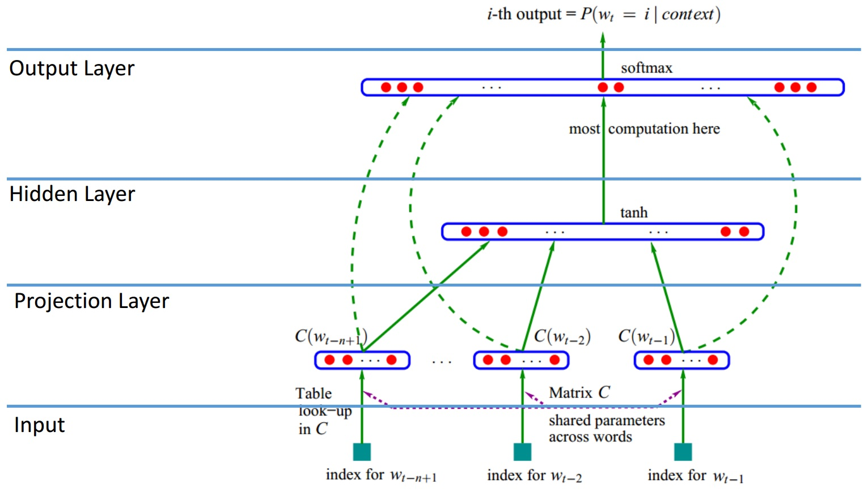
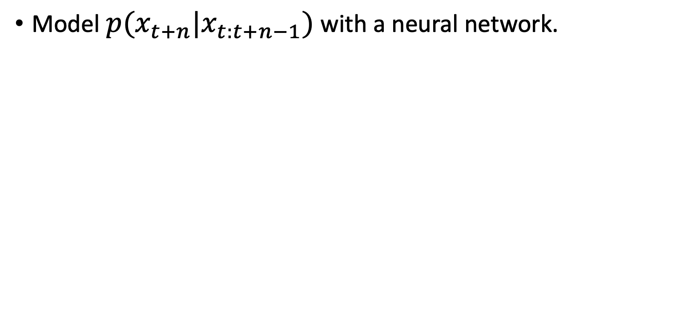
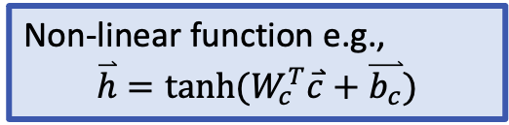
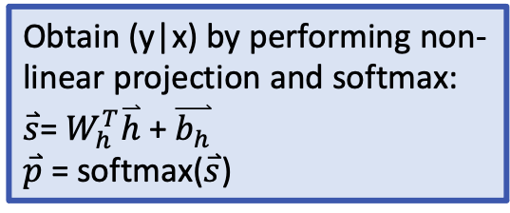
Rcall Feedforward Neural language model
Model $p(x_{t+n}|x_{t:t+n−1})$ with a neural network.
Obtain (y|x) by performing non-linear projection and softmax:
$\overset{⃑}{s}$= $W_{h}^{T}\overset{⃑}{h}$ + $\overset{⃑}{b_{h}}$
$\overset{⃑}{p}$ = softmax($\overset{⃑}{s}$)
Y. Bengio et al., JMLR’03
Non-linear function e.g.,
$$\overset{⃑}{h}=tanh⁡(W_{c}^{T}\overset{⃑}{c}+\overset{⃑}{b_{c}})$$
Concatenate projected vectors to get multi-word contexts.
Word representations to project inputs into low-dimensional vectors

Slide 5
Recurrent Neural Networks (RNNs)
Main idea: make use of sequential information
How RNN is different from feedforward neural network?
Feedforward neural networks assume all inputs are independent of each other
Feedforward neural networks look at a fixed context window
In many cases (especially for language), these are not idea
What does RNNs do?
Perform the same computation at every step of a sequence (that’s what recurrent stands for)
Inputs to the next step depend on previous computations
Another way of interpretation – RNNs have a “memory”
To store previous computations

Slide 6
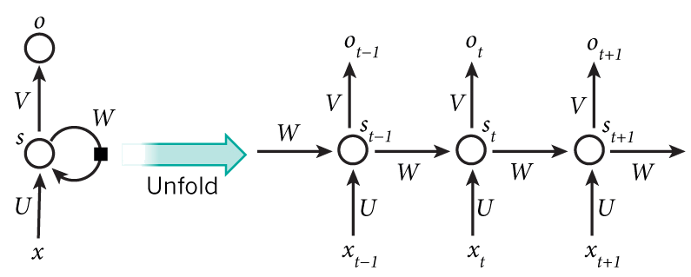
Recurrent Neural Networks (RNNs)
Hidden state at time step t
Output state at time step t
Activation function
h
h_{t-1}
h_{t}
h_{t+1}
Input at time step $t−1$
Parameters (recurrently used)

Slide 7
Recurrent Neural Networks (RNNs)
Hidden state at time step t
Output state at time step t
Activation function
h
h_{t-1}
h_{t}
h_{t+1}
Input at time step $t−1$
Parameters (recurrently used)

Slide 8
Recurrent Neural Networks (RNNs)
Mathematically, the computation at each time step:
Linear combination of the current input and previous step’s “memory”
Activation function (add non-linearity)
h
Linear transformation to convert current “memory” to output vec.
Make predictions based on the output vec.

Slide 9
Long-Term Dependencies
Is RNN capable of capturing long-term dependencies?
What does it mean by “long-term”? Consider an example
Kevin's eye was caught by one number that was highlighted in the last report; this number represented the new algorithm's ability to create lengthy and coherent text on its own. This is unprecedented. The text contained more than 500 words, but the algorithm had generated many more than that – several thousands in fact. Kevin opened up two other files that contained several thousand words of AI generated text each. ...[52 words]...
Kevin rubbed his hands together in ___

Slide 10
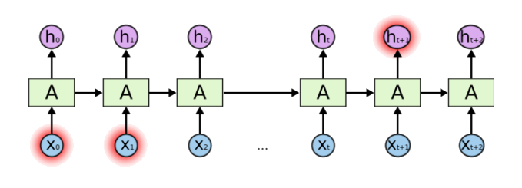
Problem of Long-Term Dependencies
What if we want to predict the next word in a long sentence?
Do we know which past information is helpful to predict the next word?
In theory, RNNs are capable of handling long-term dependencies.
But in practice, they are not! Reading: vanishing gradient problem.
Notes:
Vanishing gradient

Slide 11
Long Short Term Memory (LSTM)
A special type of recurrent neural networks.
Explicitly designed to capture the long-term dependency.
It solves/mitigates the vanishing gradient problem of vanilla RNN.
So, what is the structural difference between RNN and LSTM?

Slide 12
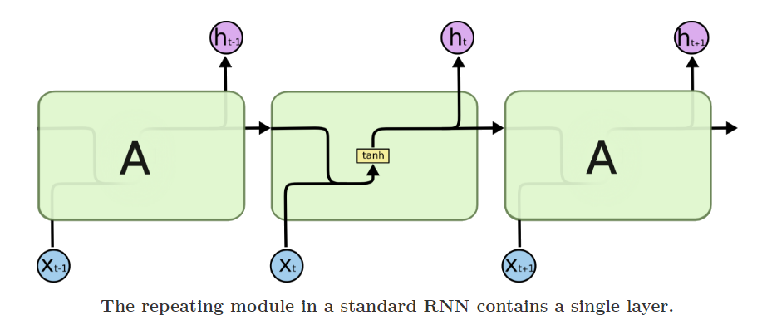
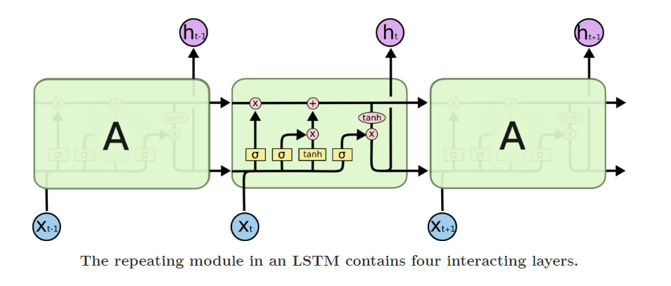
Difference between RNN and LSTM

Slide 13
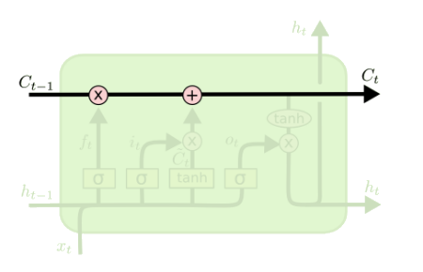
Core Idea Behind LSTM
Key to LSTMs is the memory cell state
LSTMs memory cells add and remove information as the sequence goes. Mathematically, it turns the cascading multiplications in vanilla RNNs into additions.
How? Through a structure called gate.
LSTM has three gates to control the memory in the cells

Slide 14
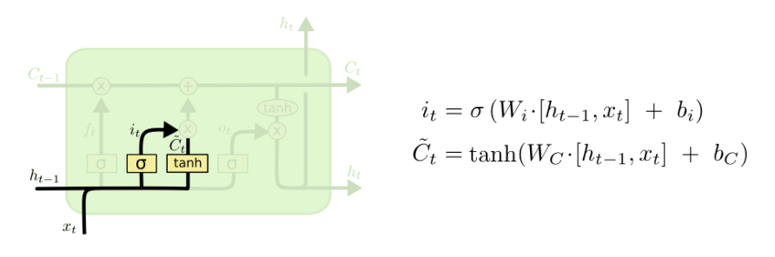
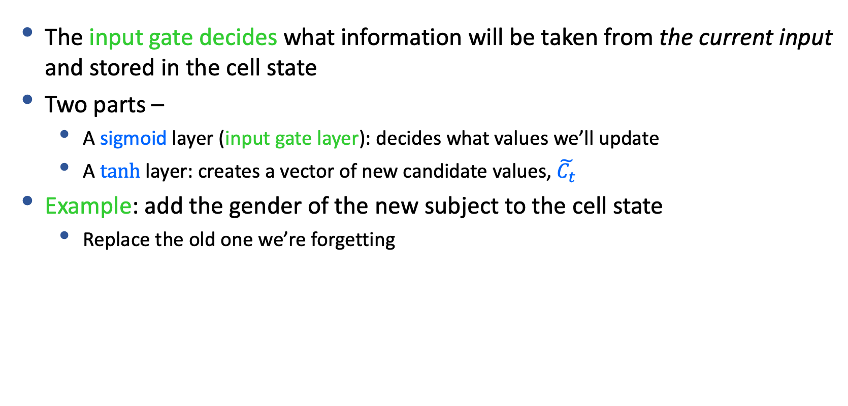
Step-by-Step LSTM Walk Through
The input gate decides what information will be taken from the current input and stored in the cell state
Two parts –
A sigmoid layer (input gate layer): decides what values we’ll update
A $tanh⁡$layer: creates a vector of new candidate values, $\tilde{C_{t}}$
Example: add the gender of the new subject to the cell state
Replace the old one we’re forgetting
Input gate layer
tanh layer

Slide 15
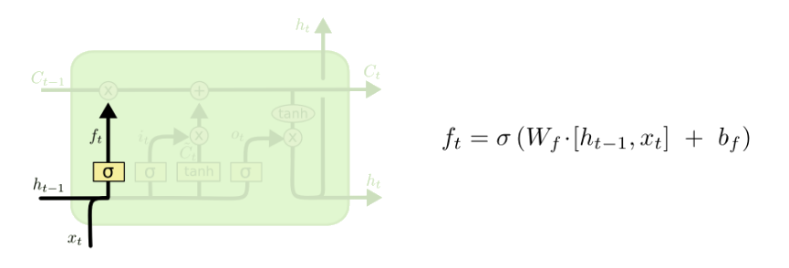
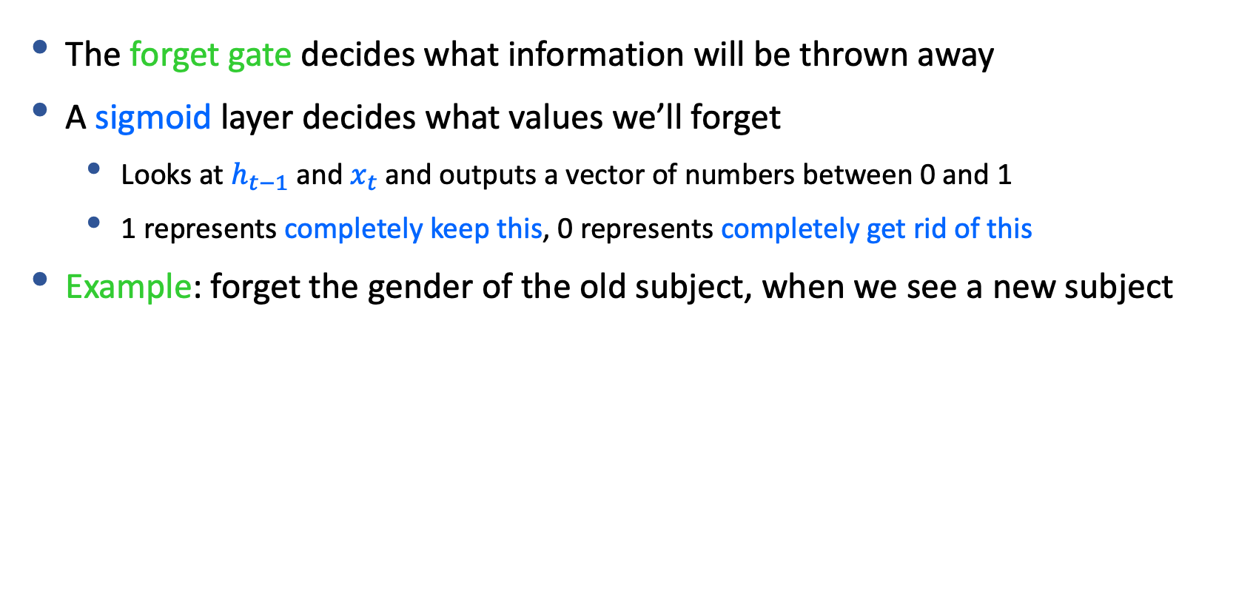
Step-by-Step LSTM Walk Through
The forget gate decides what information will be thrown away
A sigmoid layer decides what values we’ll forget
Looks at $h_{t−1}$ and $x_{t}$ and outputs a vector of numbers between 0 and 1
1 represents completely keep this, 0 represents completely get rid of this
Example: forget the gender of the old subject, when we see a new subject

Slide 16
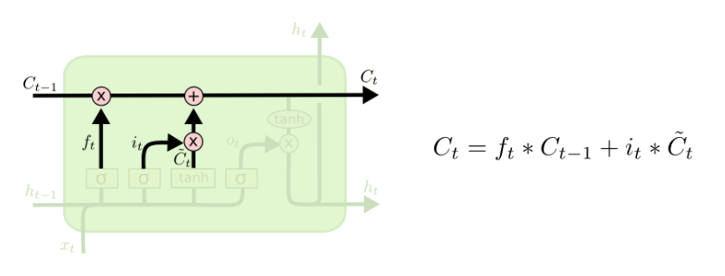
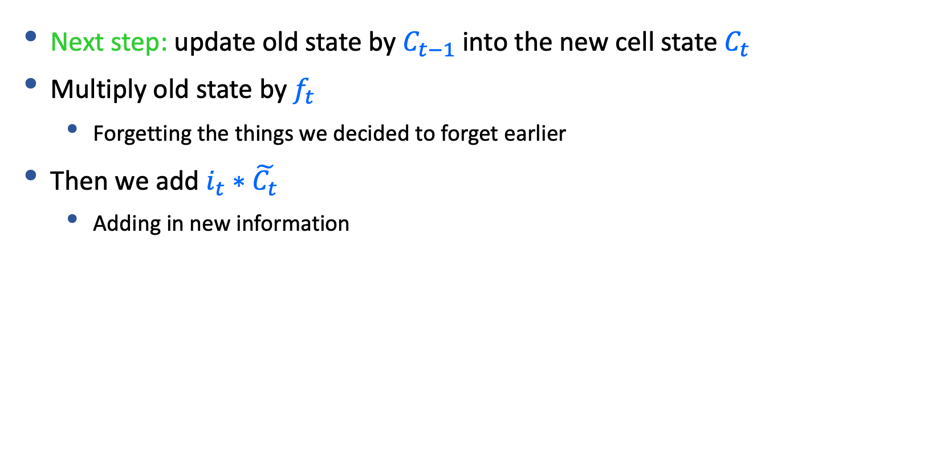
Step-by-Step LSTM Walk Through
Next step: update old state by $C_{t−1}$ into the new cell state $C_{t}$
Multiply old state by $f_{t}$
Forgetting the things we decided to forget earlier
Then we add $i_{t}∗\tilde{C_{t}}$
Adding in new information

Slide 17
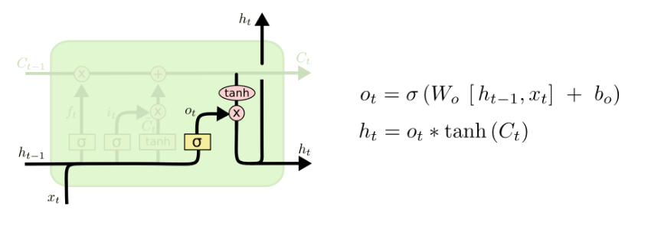
Step-by-Step LSTM Walk Through
Final step: decide what we’re going to output
First, we compute an output gate
Which decides what parts of the cell state we’re going to output
Then, we put the cell state through tanh and multiply it by the output of the sigmoid gate

Slide 18
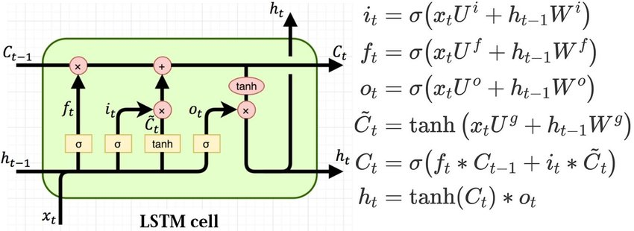
Putting Everything Together
Calculate the gates
Input information
Central memory
Output information

Slide 19
LSTMs Summary
LSTMs is an (advanced) variation of RNNs.
It captures long-term dependencies of the inputs.
Shown to be efficient in many NLP tasks.
A standard component to encode text inputs during 2014 - 2018.

Slide 20
RNN/LSTM Language Models

Slide 21
RNN/LSTM Language Models
Model the probability of the next word at each step.
P_{RNN}(x_{t}|x_{t-1}, h_{t-2})
P_{RNN}(x_{t+1}|x_{t}, h_{t-1})
P_{RNN}(x_{t+2}|x_{t+1}, h_{t})
h
h_{t-1}
h_{t}
h_{t+1}
Handles infinite context in theory

Slide 27
Learning neural language models
Maximize the log-likelihood (minimize negative log-likelihood) of observed data, w.r.t. parameters θ of the neural language model
Parameters θ (in an RNN language model):
Word embedding matrix R
RNN weights: W, U, b, V, c
LSTM weights: W^{i}, W^{f}, Wº, W^{g}, U^{i}, U^{f}, Uº, U^{g} (optional, b^{i}, b^{f}, bº, b^{g})
Gradient descent with learning rate η:
auto-gradient

Slide 28
Decoding algorithms for LMs

Slide 29
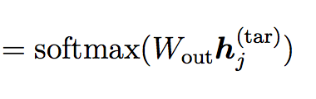
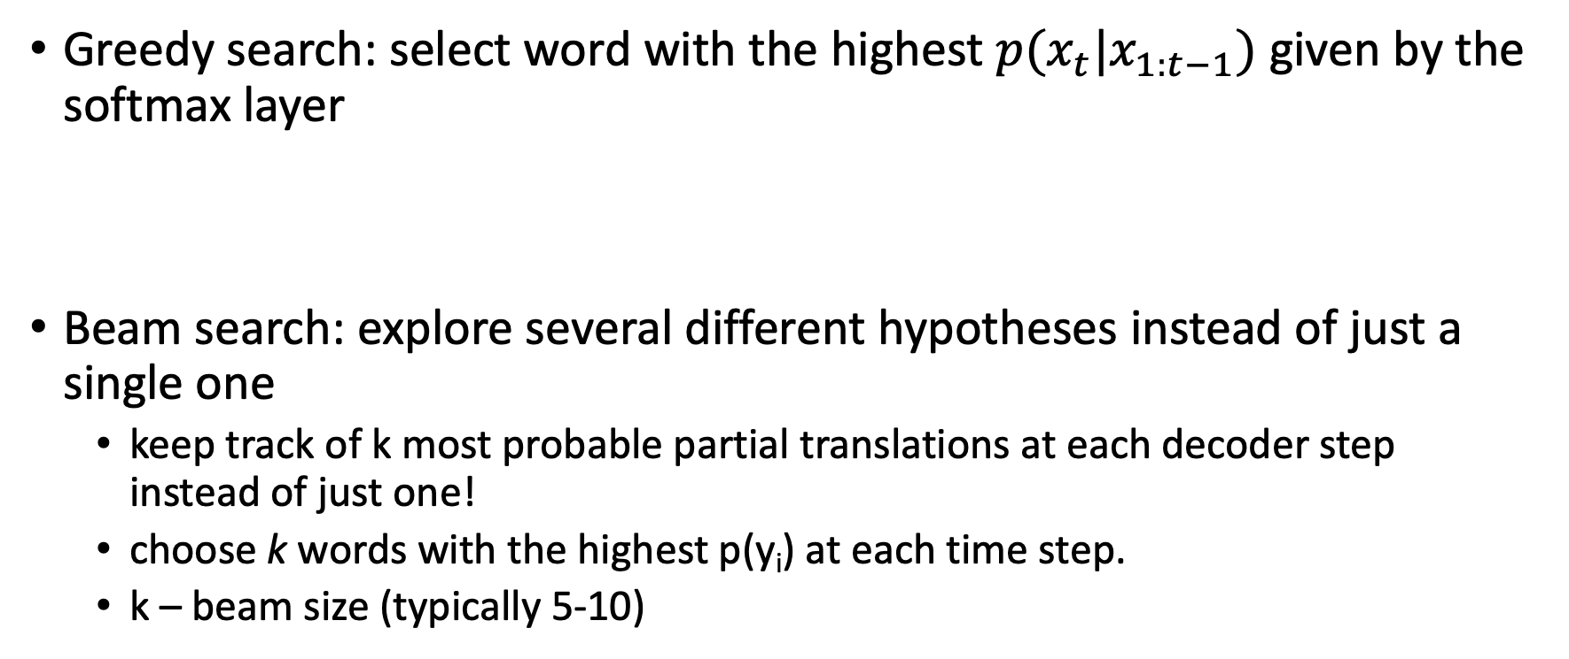
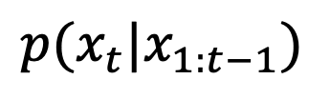
Decoding: selecting the word to generate at each time step
Greedy search: select word with the highest $p(x_{t}|x_{1:t−1})$ given by the softmax layer
Beam search: explore several different hypotheses instead of just a single one
keep track of k most probable partial translations at each decoder step instead of just one!
choose k words with the highest p(y_{i}) at each time step.
k – beam size (typically 5-10)
Issues?
$$p(x_{t}|x_{1:t−1})$$

Slide 30
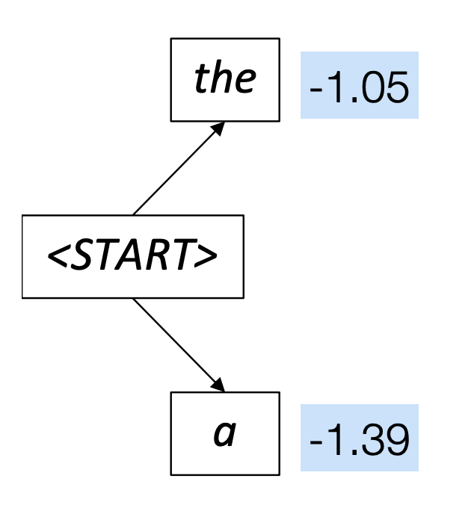
Beam search decoding: example
Beam size = 2

Slide 31
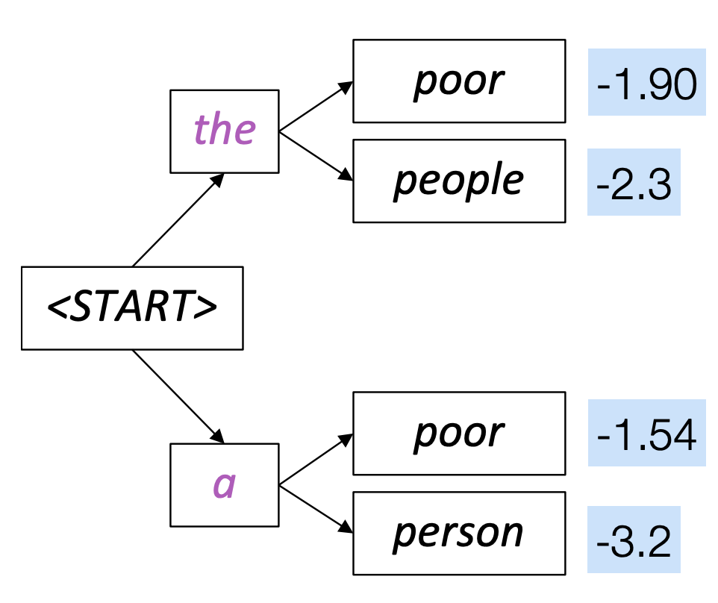
Beam search decoding: example
Beam size = 2

Slide 32
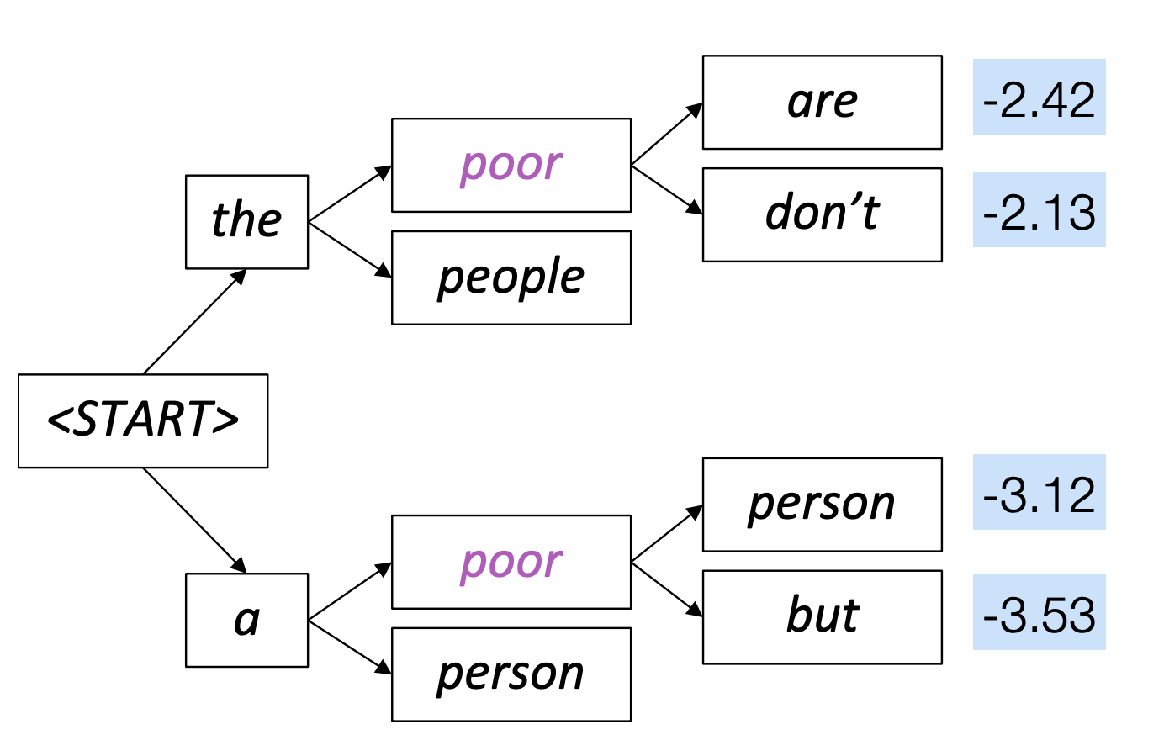
Beam search decoding: example
Beam size = 2

Slide 33
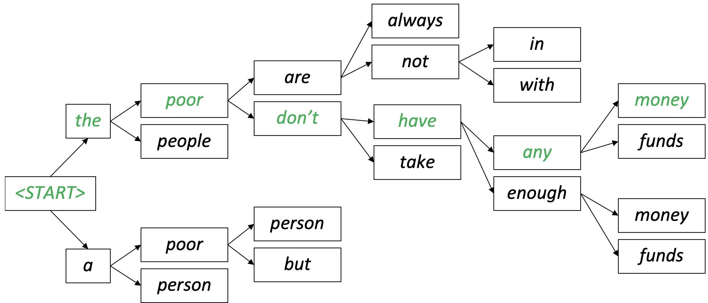
Beam search decoding: example
Beam size = 2 A few steps later…..

Slide 34
Does beam search always return the most probable sequence?
What are the termination conditions of beam search?

Slide 35
What’s the effect of changing beam size k?
Small k has similar problems to greedy decoding (k=1)
Unnatural, incorrect (due to errors in earlier decoding stage), generic
Larger k means you consider more hypotheses
Increasing k reduces some of the problems above
Larger k is more computationally expensive
Increasing k can also introduce other problems
E.g., in open-ended tasks like chit-chat dialogue, large k can make output more generic

Slide 36
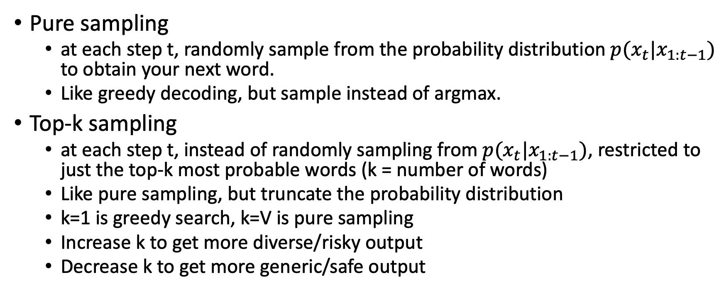
Sampling-based decoding
Pure sampling
at each step t, randomly sample from the probability distribution $p(x_{t}|x_{1:t−1})$ to obtain your next word.
Like greedy decoding, but sample instead of argmax.
Top-k sampling
at each step t, instead of randomly sampling from $p(x_{t}|x_{1:t−1})$, restricted to just the top-k most probable words (k = number of words)
Like pure sampling, but truncate the probability distribution
k=1 is greedy search, k=V is pure sampling
Increase k to get more diverse/risky output
Decrease k to get more generic/safe output

Slide 37
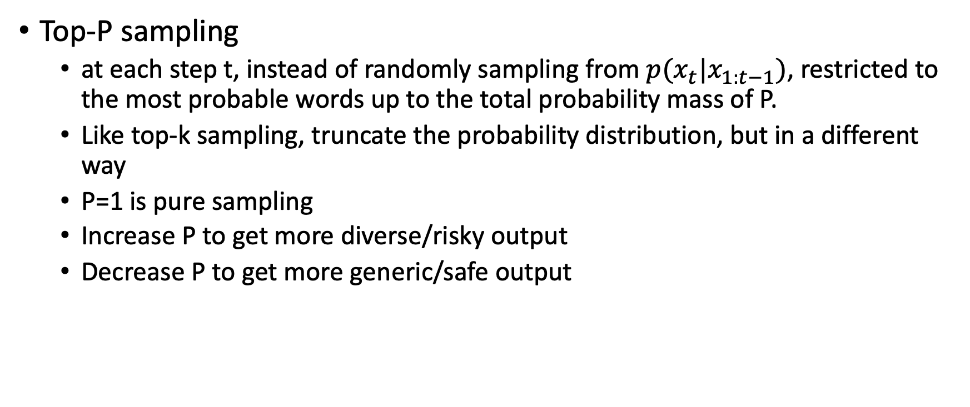
Sampling-based decoding
Top-P sampling
at each step t, instead of randomly sampling from $p(x_{t}|x_{1:t−1})$, restricted to the most probable words up to the total probability mass of P.
Like top-k sampling, truncate the probability distribution, but in a different way
P=1 is pure sampling
Increase P to get more diverse/risky output
Decrease P to get more generic/safe output

Slide 38

Comparing different sampling strategies
The Curious Case of Neural Text Degeneration, Holtzman et al., 2020

Slide 39
Decoding algorithms: summary
Greedy decoding is a simple method; usually gives low quality output
Beam search (especially with large beam size) searches for high probability output
Delivers better quality than greedy, but if beam size is too large, can return high-probability but unsuitable output (e.g. generic, short)
Sampling methods are a way to get more diversity and randomness
Good for open-ended / creative generation (chit-chat, poetry, stories)
Top-k and top-p sampling allows you to control diversity

Slide 40
Next: Sequence-to-sequence modeling
Sequence-to-sequence tasks
RNN/LSTM-based seq2seq models
Seq2seq with attention

